Slide 1

Energy and Environmental Engineering
Dr. Kamlesh Sorate
Assistant Professor SVNIT, SURAT
Fuels & Properties

Slide 2
Contents
Definition of Fuel
Classification of fuel
Properties of Solid, Liquid, Gaseous fuels
Merits and Demerits of Liquid Fuels over Solid Fuels
Merits and Demerits of gaseous fuels
Requirement of a good fuel

Slide 3
Contents
Calorific value of fuels
Higher or gross calorific value
Lower or Net calorific value
Calorific value at constant pressure and constant volume
Carbon value of fuels
Estimation of calorific value of fuels
Dulong’s formula
By actual experiments

Slide 4
Fuels
Fuel is any material that stores potential energy in a form that can be practicably released and used as heat energy
Fuel may be chemical or nuclear ( we will study briefly chemical fuels only)
A chemical fuel is a substance which releases heat energy on combustion.
Principal combustible elements of each fuel are carbon and hydrogen.

Slide 5
Though sulphur is a combustible element too but its presence in the fuel is considered to be undesirable.
Fuels are contrasted with other substances or devices storing potential energy, such as those that directly release electrical energy (such as batteries and capacitors) or mechanical energy (such as flywheels, springs, compressed air, or water in a reservoir).

Slide 6
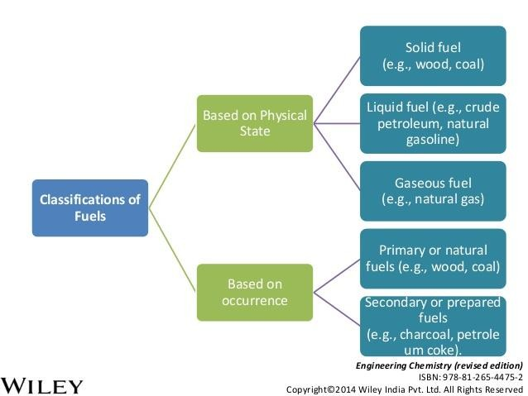
Classification of Fuels

Slide 7
Primary fuels are the ones which occur in nature
While Secondary fuels are the prepared or derived fuels from the primary fuels.

Slide 8
Liquid Fuels
Liquid fuels are combustible or energy-generating molecules that can be harnessed to create mechanical energy,
Liquid fuels like furnace oil and LSHS (Low sulphur heavy stock) are predominantly used in industrial applications.
Most liquid fuels in widespread use are derived from the fossil sources

Slide 9
However, there are several types, such as hydrogen fuel (for automotive uses), ethanol, jet fuel and biodiesel which are all categorized as a liquid fuel.

Slide 10
Types of liquid fuels
Petroleum
Oils from distillation of petroleum
Coal tar
Shale-oil
Alcohols, etc.

Slide 11
Properties of liquid fuels
DENSITY-
Density is defined as the ratio of the mass of the fuel to the volume of the fuel at a reference temperature of 15°C.
The unit of measurement for density is kg/m3 and measured by a hydrometer.
It is important for assessing ignition qualities and other quantitative calculations.

Slide 12

Hydrometer
Notes:
Hydrometer

Slide 13
SPECIFIC GRAVITY-
The specific gravity is a ratio, which is defined as the ratio of the weight of a given volume of oil to the weight of the same volume of water at a given temperature.
The density of fuel, relative to water is called specific gravity.
E.g. Light diesel oil has specific gravity as 0.85 - 0.87, furnace oil has 0.89 - 0.95.

Slide 14
VISCOSITY-
The viscosity of a fluid is a measure of its internal resistance to flow.
Viscosity depends on the temperature and decreases as the temperature increases.
FLASH POINT
The flash point of a fuel is the lowest temperature at which the fuel can be heated so that the vapour gives off flashes momentarily when an open flame is passed over it.
The 66 °C is the flash point for furnace oil.
FIREPOINT

Slide 15
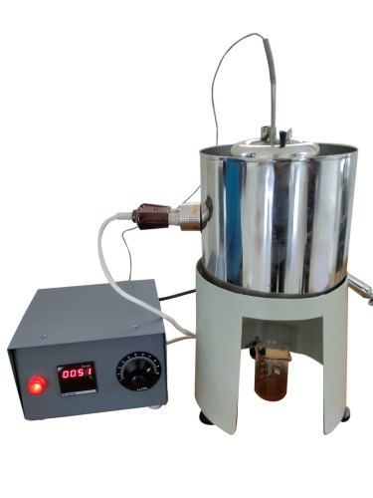
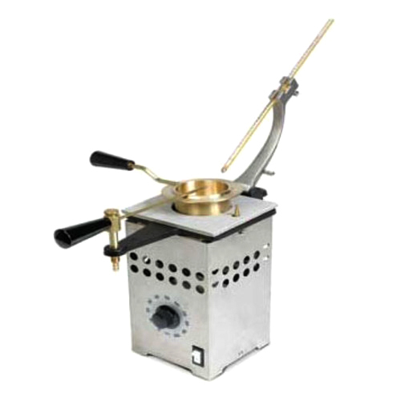
Flash and fire point apparatus
Redwood viscometer
Notes:
Redwood viscometer
Flash and fire point apparatus

Slide 16
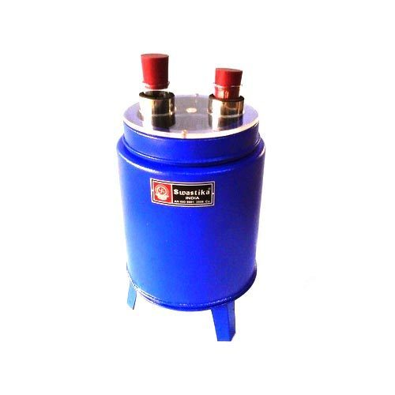
Cloud and pour point
Notes:
Cloud and pour point

Slide 17
POUR POINT-
It is the fuel's lowest temperature at which it will pour or flow when cooled under prescribed conditions. It is a rough estimation of the lowest temperature at which fuel oil is ready to be pumped.
SPECIFIC HEAT-
Specific heat is the amount of calories needed to raise the temperature of 1 kg of oil by 1⁰C. The unit of specific heat is kcal/kg⁰C. It varies from 0.22 to 0.28 depending on the oil specific gravity.

Slide 18
CALORIFIC VALUE-
The calorific value measures the heat or energy produced. Gross calorific value (GCV) assumes all vapour produced during the combustion process is fully condensed and Net calorific value (NCV) assumes the water leaves with the combustion products without fully being condensed.
Fuels should be compared based on the net calorific value. The calorific value of fuel oils is much more consistent compare to coal (solid fuel), for example kerosene and diesel oil got the GCV 11,100 and 10,800 kCal/kg respectively.
* Multiply by 4.18 to convert kCal to kJ
Notes:
* Multiply by 4.18 to convert kCal to kJ

Slide 19
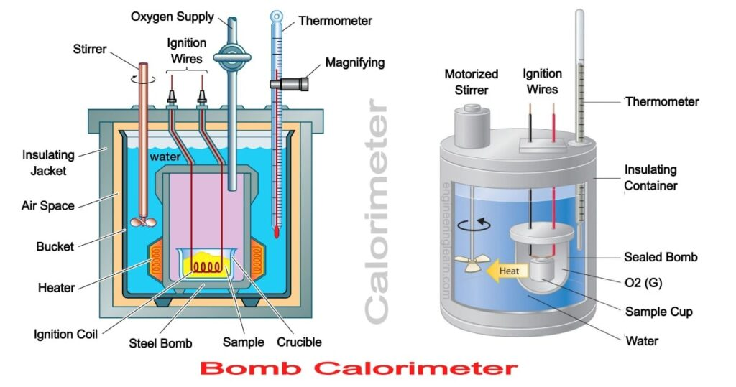
Bomb calorimeter
Notes:
Bomb calorimeter

Slide 20
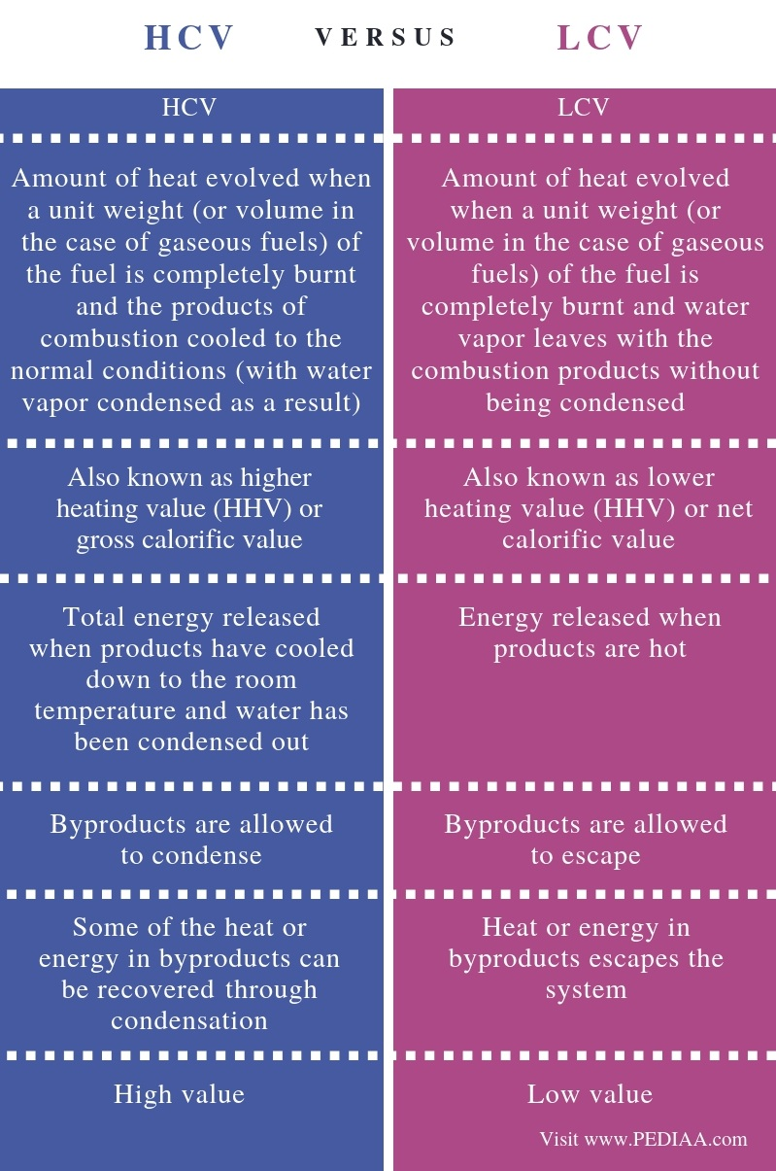

Slide 21
SULPHUR-
The amount of sulphur in the fuel oil depends on the source of the crude oil and on the refining process.
The sulphur content for the residual fuel oil is in the order of 2 - 4 %.
CARBON RESIDUE-
Carbon residue indicates the tendency of oil to deposit a carbonaceous solid residue on a hot surface like burner and injection nozzle when its vaporizable constituents evaporate.
The residual oil contains carbon residue of 1% or higher.

Slide 22
ASH CONTENT-
The ash value is related to the inorganic material or salts(compounds of sodium, vanadium, calcium, magnesium, silicon, iron, aluminum, nickel etc.) in the fuel oil and ash levels in distillate fuels are negligible. the residual fuels have higher ash levels.
The ash has an erosive effect on the burner tips, causes damage to the refractories at high temperatures and gives rise to high temperature corrosion and fouling of equipment's.

Slide 23
WATER CONTENT-
The water content are low when it is supplied because the product at refinery site is handled hot, the water content can be maximum 1% which the upper limit.
The water content can cause damage to the inside surfaces of the furnace during combustion especially if it contains dissolved salts or it can cause spluttering of the flame at the burner tip, possibly extinguishing the flame, reducing the flame temperature or lengthening the flame.

Slide 24
Advantages of Liquid Fuels
They posses higher calorific value per unit mass than solid fuels.
They burn without dust, ash, clinkers, etc.
Their firing is easier and also fire can be extinguished easily by stopping liquid fuel supply.
They are easy to transport through pipes.
They can be stored indefinitely without any loss.
They are clean in use and economic to handle.
Loss of heat in chimney is very low due to greater cleanliness.
They require less excess air for complete combustion.
They require less furnace space for combustion.

Slide 25
Disadvantages of liquid fuel
The cost of liquid fuel is relatively much higher as compared to solid fuel.
There is a greater risk of fire hazards, in case of highly inflammable and volatile liquid fuels.
They give bad odour.
Special storage tanks are required for storing liquid fuels.
Specially constructed burners and spraying apparatus are required for efficient burning of liquid fuels.

Slide 26
Gross calorific values for different fuel oils
Gross Calorific Value (kCal/kg)
11,100
10,800
10,700
10,500
10,600
Fuel oils
Fuel Oil Diesel Oil L.D.O
Furnace Oil LSHS
* Multiply by 4.18 to convert kCal to kJ

Slide 27
Solid Fuels
Solid fuel refers to various types of solid material that are used as fuel to produce energy and provide heating, usually released through combustion.
Solid fuels are mainly classified into two categories, i.e. natural fuels, such as wood, coal, etc. and manufactured fuels, such as charcoal, coke, briquettes, etc.
Coal is classified into three major types; anthracite, bituminous, and lignite.

Slide 28
Solid Fuels
Coal is further classified as semi-anthracite, semi-bituminous, and sub-bituminous.
Anthracite is the oldest coal from a geological perspective. It is a hard coal composed mainly of carbon with little volatile content and practically no moisture.

Slide 29
Solid Fuels
Types of solid fuel
Wood
Coal
Oil shale
Tanbark
Bagasse
Straw
Charcoal
Coke
Briquettes

Slide 30
Solid Fuels
Anthracite
It is very hard coal and has a shining black lustre.
It is non-caking and has high percentage of fixed carbon.
The calorific value of this fuel is high to the tune of 35500kJ/kg and as such is very suitable for steam generation

Slide 31
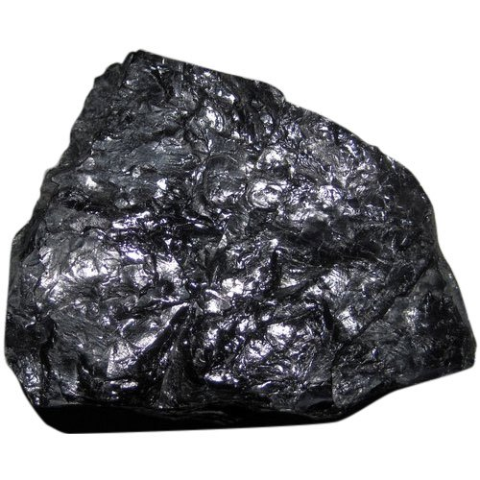
Solid Fuels
Bituminous
It burn with long yellow and smoky flames and high percentage of volatile matter.
The average calorific value of bituminous coal is about 31350 kJ/kg.
It may be of two types –caking and non-caking.

Slide 32
Solid Fuels
Lignite OR brown coals
These are intermediate stages between peat and coal.
They have a woody or often a clay like appearance associated with high moisture, high ash and low heat contents.
Lignite are usually amorphous in character and impose transport difficulties as they break easily. They burn with a smoky flame. Some of this type are suitable for local use only.

Slide 33
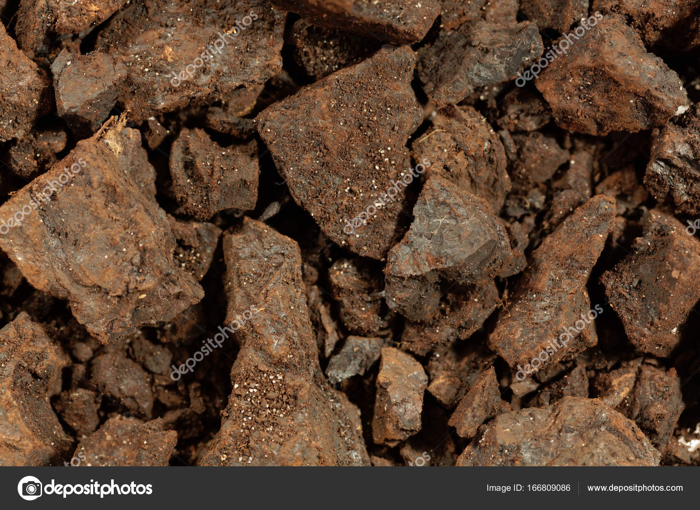
Lignite OR brown coals

Slide 34
Wood
The woods are very easily available and most commonly used solid fuel.
The woods are used as fuel from ancient time after the discovery of the fire.
The wood is used for industrial purposes. Constituents of Wood is vegetable tissue of trees and bushes.
The wood consists of mainly cellular tissue & lignin. It also consists of lesser parts of fat & tar and sugar.

Slide 35
Wood
Wood mainly consists of carbon and Hydrogen.
The wood is converted into coal when burnt in absence of air.
The average value calorific value of the wood is 19700 kJ/kg.

Slide 36
Advantages of Solid fuels
Easier transportation and storage.
Low production cost.
Moderate ignition temperature.

Slide 37
Disadvantages of solid fuel
Large portion of energy is wasted.
Cost of handling is high and controlling is also hard.
Ash content is high & burn with clinker formation.

Slide 38
Gaseous fuels
Gaseous fuels may be divided into four classes: natural gas, producer gas, water gas and coal gas.(SynGas/Synthesis gas)
Producer gas is the product obtained when coal or coke is burnt with air deficiency and with a controlled amount of moisture.
Syngas, or synthesis gas, is a fuel gas mixture consisting primarily of hydrogen, carbon monoxide, and very often some carbon dioxide. ... Syngas is usually a product of coal gasification and the main application is electricity generation. Syngas is combustible and can be used as a fuel of internal combustion engines

Slide 39
Merits of gaseous fuels
Economy in fuel and extra efficiency of engine.
This is compressible, and therefore, storage will be easier.
A large amount less air is required for complete combustion.
Less Starting troubles and freezing problems are remove.
A gaseous fuel can simply carried through pipes.
Engine can be run with Lean mixture.

Slide 40
Demerits of gaseous fuels
Purification cost is elevated
Storage capacity per unit energy is reasonably extremely large
High cost and size and weight of engine are reasonably large

Slide 41
Requirement of good fuel
It should have a high calorific value i.e., it should evolve a large amount of heat when it is burnt.
Its moisture content should be low so that its heating value should be high.
An ideal fuel should have moderate ignition temperature.
It should not produce harmful products like CO₂,, SO₂,, H₂S and other poisonous gases on burning since they pollute the atmosphere

Slide 42
Requirement of good fuel
A fuel should have low content of non- combustible matter in the form of ash or clinker. Since the presence of non-combustible matter will enhance the cost of storage, handling and disposal of waste.
The combustion of fuel should be controllable so that it can be started or stopped.
It should not give any offensive odour.
It should have moderate velocity of combustion

Slide 43
Calorific Value of fuels
Higher or Gross CV
The amount of heat obtained by the complete combustion of 1 kg of fuel, when the products of its combustion are cooled down to the temperature of air supplied (usually taken as 15ºC), is called the gross or higher calorific value.
Lower or Net CV
When the heat absorbed or carried away by the products of combustion is not recovered and the steam formed during combustion is not condensed

Slide 44

Carbon value of fuels
The number of kgs of carbon required to produce the same amount of heat as one kg of fuel is known as the carbon value of fuel and is given by the relation:

Slide 45

Estimation of calorific value
Dulong’s formula
𝐿. 𝐶. 𝑉. = 𝐻. 𝐶. 𝑉. −𝐻𝑒𝑎𝑡 𝑜𝑓 𝑠𝑡𝑒𝑎𝑚 𝑓𝑜𝑟𝑚𝑒𝑑 𝑑𝑢𝑟𝑖𝑛𝑔 𝑐𝑜𝑚𝑏𝑢𝑠𝑡𝑖𝑜𝑛
𝐿. 𝐶. 𝑉. = 𝐻. 𝐶. 𝑉. −(9𝐻₂ × 2466)
By actual experiments
Bomb calorimeter
Boys calorimeter

Slide 46
Proximate and Ultimate analysis
Proximate:
moisture,
ash,
volatile matter, and
fixed carbon
Ultimate
major organic elemental composition
C, H, N, S, O

Slide 47
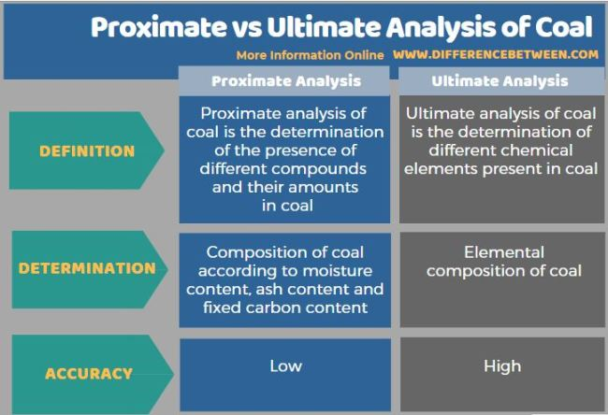

Slide 48
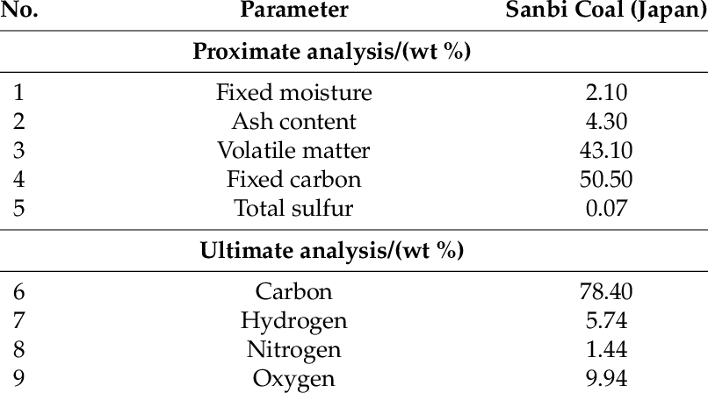

Slide 49
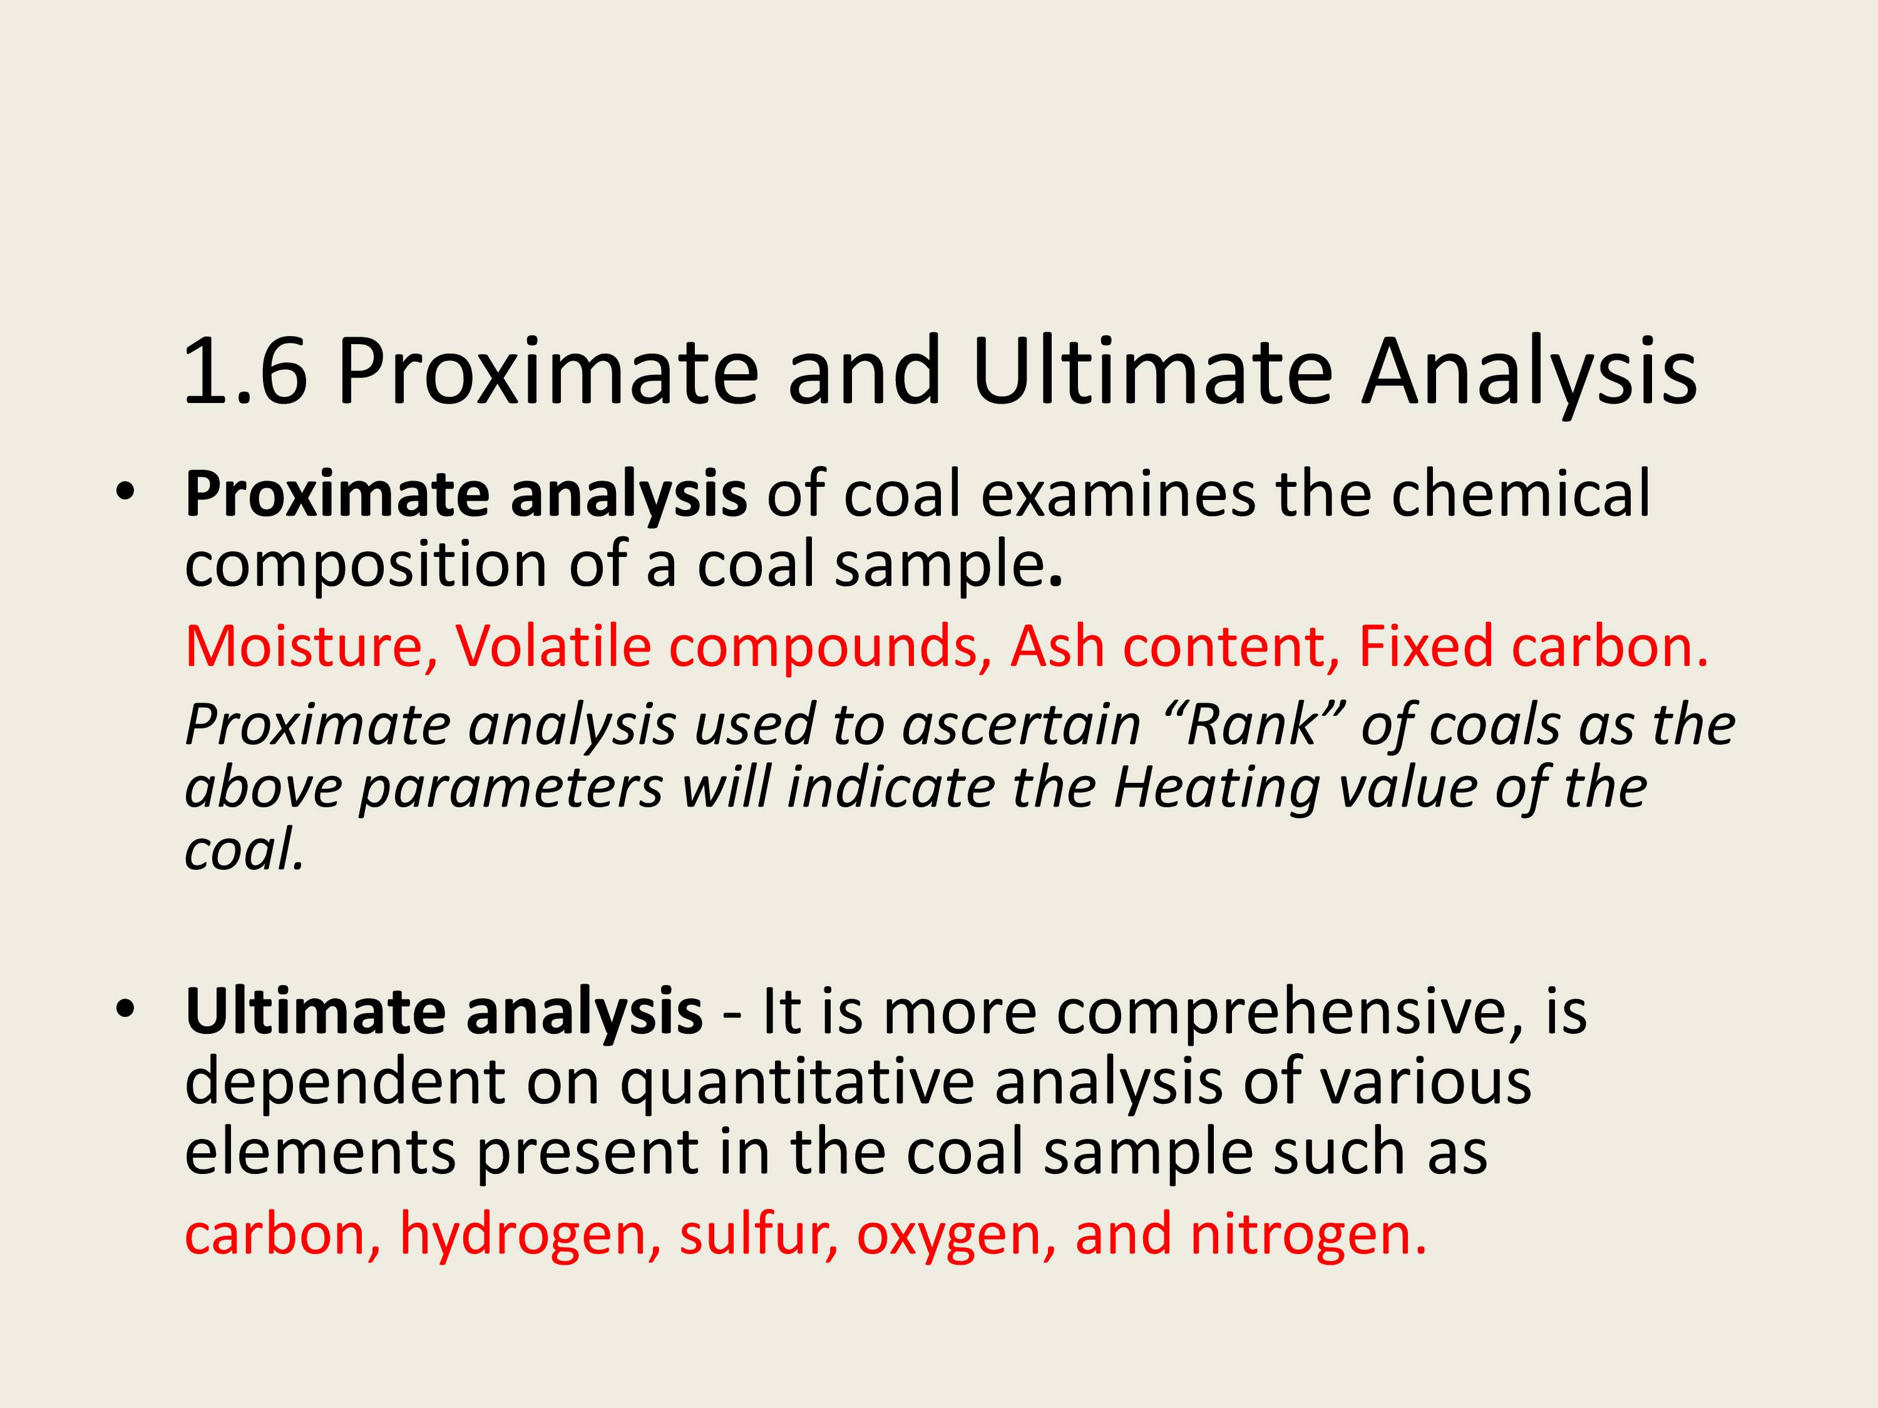

Slide 50
Combustion of fuel
C+O2=Co2
CxHy+O2=CO2+H2O

